Slide 1
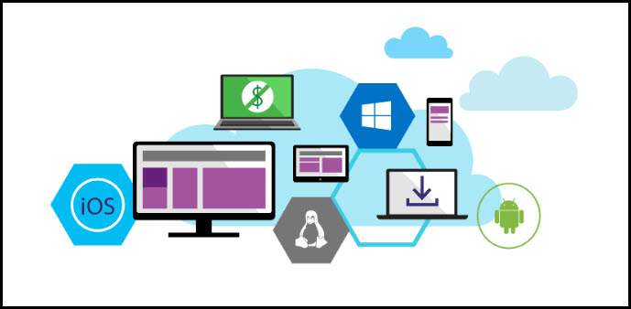
Application Lifecycle Management: It’s a Team Sport
Student: Ceaușescu Ciprian Mihai
Îndrumător: prof. dr. Stefănescu Alin

Slide 2

Application Lifecycle Management
Modern application development
Continuous value delivery
Rapid response to change

Slide 3
Continuous Value Delivery
Define
Ideation
REQUIREMENTS
PRODUCT
BACKLOG
Develop
Idea to working software
Sprint
Monitor
Operate
Deployment to feedback
OPS
BACKLOG
WORKING SOFTWARE

Slide 4

Stakeholder Involvement
Define
Ideation
REQUIREMENTS
PRODUCT
BACKLOG
Misunderstood Requirements
Conflicting Priorities
Develop
Idea to working software
Sprint
Monitor
Operate
Deployment to feedback
OPS
BACKLOG
Unmet user expectations
WORKING SOFTWARE

Slide 5
Developer Team Productivity
Define
Ideation
REQUIREMENTS
PRODUCT
BACKLOG
Quality Suffers
Develop
Idea to working software
Sprint
Monitor
Losing Focus
Operate
Deployment to feedback
Late Delivery
OPS
BACKLOG
WORKING SOFTWARE

Slide 6
DevOps
Define
Ideation
REQUIREMENTS
PRODUCT
BACKLOG
Can’t Get Actionable Feedback
Can’t Reproduce Production Incident
Develop
Idea to working software
Sprint
Monitor
Operate
Deployment to feedback
OPS
BACKLOG
WORKING SOFTWARE

Slide 7
Continuous Value Delivery
Define
Ideation
REQUIREMENTS
PRODUCT
BACKLOG
PowerPoint Storyboarding
Agile Planning
Operate
Deployment to feedback
Develop
Idea to working software
Sprint
Monitor
SCOM Integration
IntelliTrace in Production
PreEmptive Analytics
Suspend & Resume
Code Reviews
Feedback Collection
Unit Testing
Exploratory Testing
Continuous Integrations
Continuous Deployments
OPS
BACKLOG
WORKING SOFTWARE

Slide 8
Go get started!
Live demo with Team Foundation Server
Thank you!

